Slide 1
Experiment – 1
PRN : 25070521165
1.1.3 Calculate Area of the Square
Algorithm
STEP 1 : Start
STEP 2 : Input side_length
STEP 3 : Calculate
area = side_length * side_length
STEP 4 : Print area
STEP 5 : Stop
Flowchart
Start
Input side_length
area = side_length * side_length
Print area
Stop

Slide 2
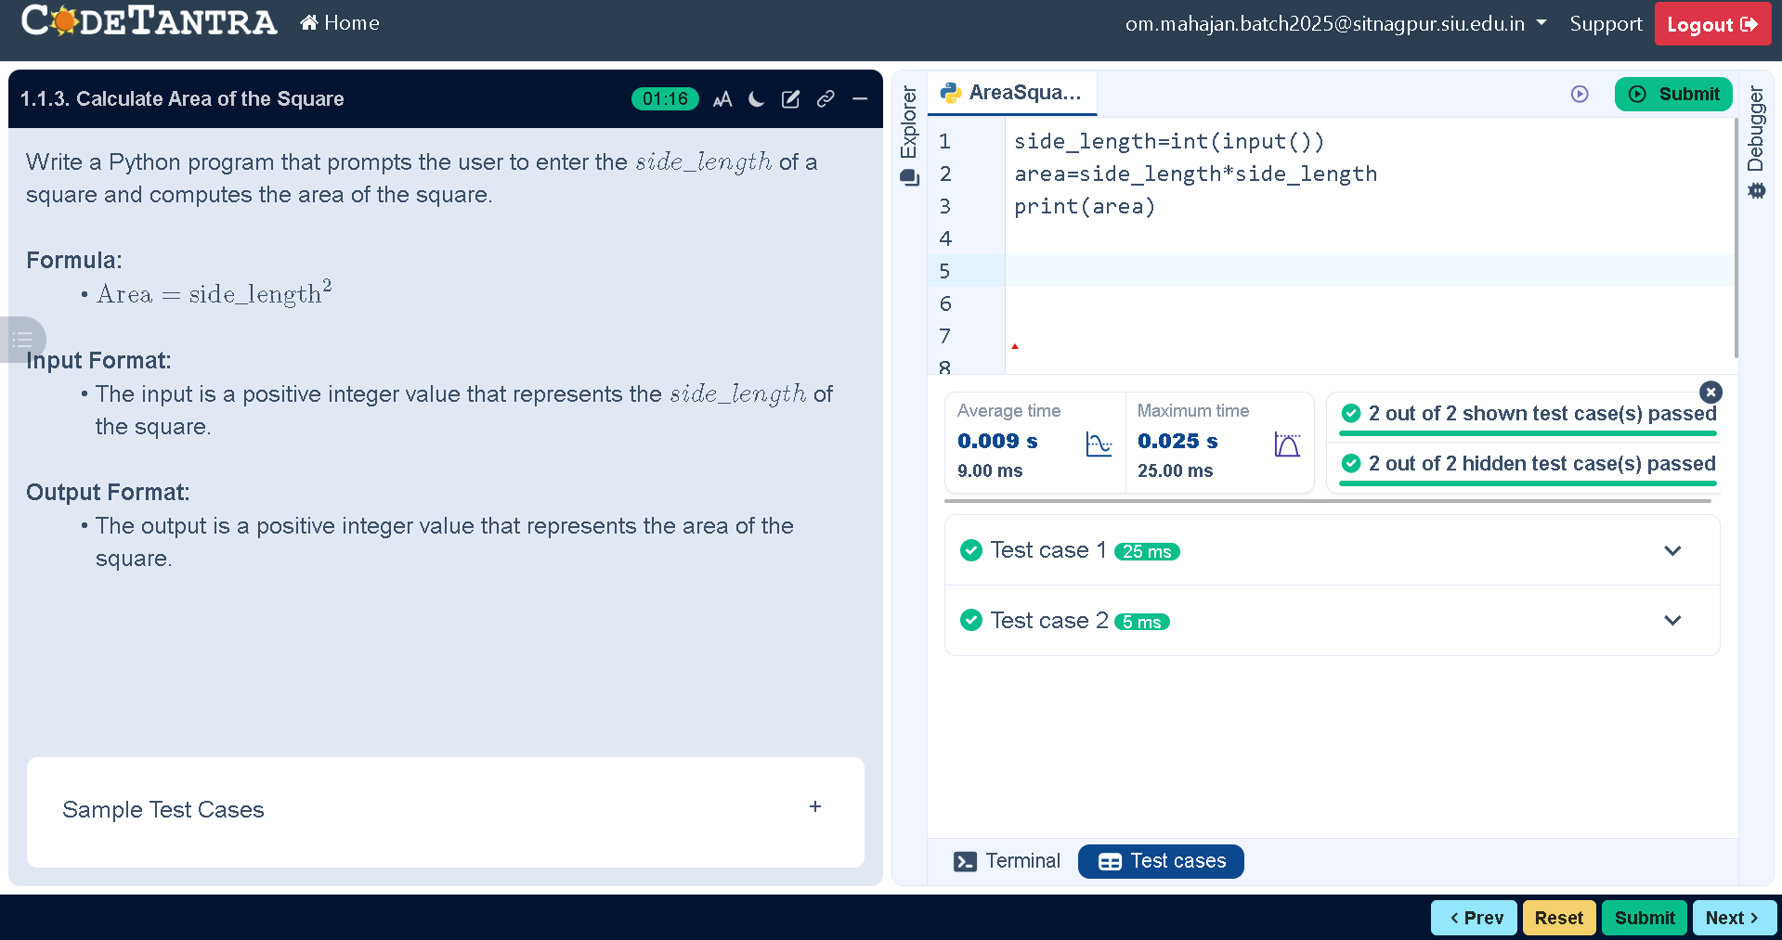
Code
PRN : 25070521165
side_length=int(input())
area=side_length*side_length
print(area)
Execution

